Slide 1
Behavioural Economics
Classical and Modern
Or
Human Problem Solving vs. Anomaly Mongering
“[W]e might hope that it is precisely in such circumstances [i.e., where the SEU models fail] that certain proposals for alternative decision rules and non-probabilistic descriptions of uncertainty (e.g., by Knight, Shackle, Hurwicz, and Hodges and Lehman) might prove fruitful. I believe, in fact, that this is the case.”
Daniel Ellsberg: Risk, Ambiguity and Decision

Slide 2
Behavioural Economics
Classical
Human Problem Solving
Undecidable Dynamics
Arithmetical Games
Nonprobabilistic Finance Theory
Underpinned by:
  Computable Economics
  Algorithmic Probability Theory
  Nonlinear Dynamics
Modern
Behavioural Microeconomics
Behavioural Macroeconomics
Behavioural Finance
Behavioural Game Theory
Underpinned by:
  Orthodox EconomicTheory
  Mathematical Finance Theory
  Game Theory
  Experimental Economics
  Neuroeconomics
  Computational Economics/ABE
  Subjective Probability Theory
The next few ‘slides’ are images of the front cover of some of the texts I use and abuse in my graduate course on behavioural economics.
See the adjoining remarks on the various books.

Slide 3
Algorithimic Possibility & Impossibility Results
The following algorithmic results are among the important defining themes in providing the key differences in the methodology and epistemology between classical and modern behavioural economics:
Nash equilibria of finite games are constructively indeterminate.
Computable General Equilibria are neither computable nor constructive.
The Two Fundamental Theorems of Welfare Economics are Uncomputable and Nonconstructive, respectively.
There is no effective procedure to generate preference orderings.
Recursive Competitive Equilibria, underpinning the RBC model and, hence, the Stochastic Dynamic General Equilibrium benchmark model of Macroeconomics, are uncomputable.
There are games in which the player who in theory can always win cannot do so in practice because it is impossible to supply him with effective instructions regarding how he/she should play in order to win.
Only Boundedly Rational, Satisficing, Behaviour is capable of Computation Universality

Slide 4

Behavioural Macroeconomics
False analogies with the way Keynes is supposed to have used and invoked the idea of ‘animal spirits’. An example of the way good intentions lead us down the garden path …..

Slide 5

Behavioural Microeconomics
A key claim is that ‘new developments in mathematics’ warrants a new approach to microeconomics – an aspect of the ‘Santa Fe vision’. A misguided vision, if ever there was one …

Slide 6
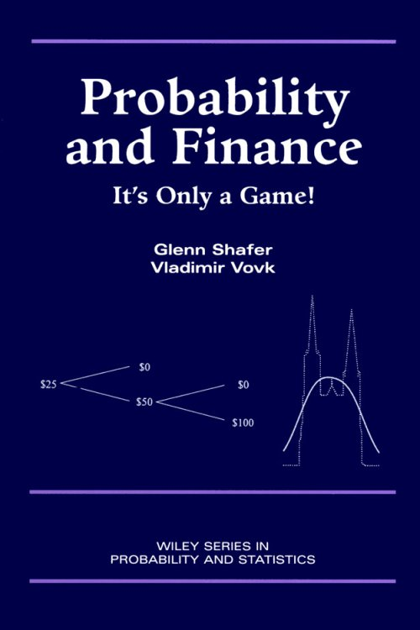
Nonprobabilistic Finance Theory
How, for example to derive the Black-Scholes formula without the Ito calculus and an Introduction to Algorithmic Probability Theory

Slide 7
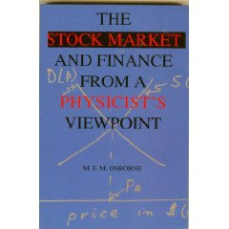
Finance Theory
Fountainhead of ‘Econophysics’!
See next slide!

Slide 8
"There are numerous other paradoxical beliefs of this society [of economists], consequent to the difference between discrete numbers .. in which data is recorded, whereas the theoreticians of this society tend to think in terms of real numbers. ...
No matter how hard I looked, I never could see any actual real [economic] data that showed that [these solid, smooth, lines of economic theory] ... actually could be observed in nature. ......
At this point a beady eyed Chicken Little might ... say, 'Look here, you can't have solid lines on that picture because there is always a smallest unit of money ... and in addition there is always a unit of something that you buy. ..
[I]n any event we should have just whole numbers of some sort on [the supply-demand] diagram on both axes. The lines should be dotted. ...
Then our mathematician Zero will have an objection on the grounds that if we are going to have dotted lines instead of solid lines on the curve then there does not exist any such thing as a slope, or a derivative, or a logarithmic derivative either. .... .
If you think in terms of solid lines while the practice is in terms of dots and little steps up and down, this misbelief on your part is worth, I would say conservatively, to the governors of the exchange, at least eighty million dollars per year.
Maury Osborne, pp.16-34

Slide 9
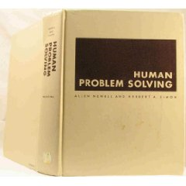
Human Problem Solving by Newell & Simon

Slide 10


Slide 11
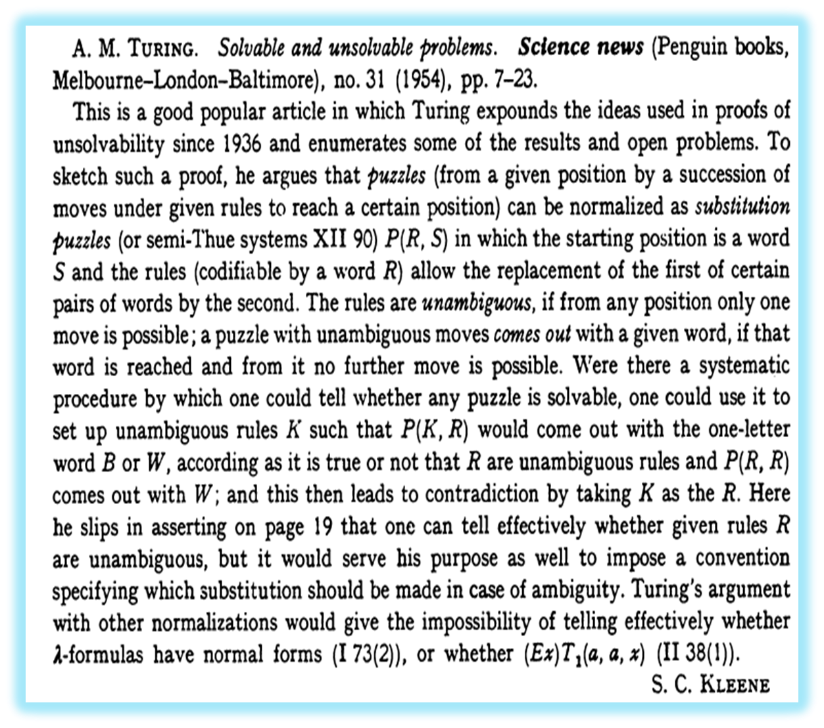

Slide 12

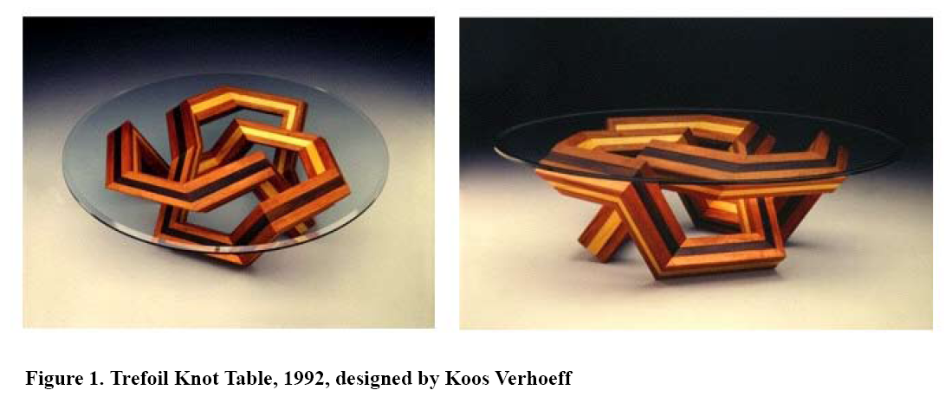
Turing and the Trefoil Knot

Slide 13
The solvability or NOT - of the ‘trefoil knot’ problem I: Turing (1954)
A knot is just a closed curve in three dimensions nowhere crossing itself;
for the purposes we are interested in, any knot can be given accurately by enough as a series of segments in the directions of the three coordinate axes.
Thus, for instance, the trefoil knot may be regarded as consisting of a number of segments joining the points given, in the usual (x,y,z) system of coordinates as (1,1,1), (4,1,1), (4,2,1), (4,2,-1), (2,2,-1), (2,2,2), (2,0,2), (3,0,2), (3,0,0), (3,3,0), (1,3,0), (1,3,1), and returning again with a twelfth segment to the starting point (1,1,1). .. There is no special virtue in the representation which has been chosen.
Now let a and d represent unit steps in the positive and negative X-directions respectively, b and e in the Y-directions, and c and f in the Z-directions: then this knot may be described as aaabffddccceeaffbbbddcee.
One can then, if one wishes, deal entirely with such sequences of letters.
In order that such a sequence should represent a knot it is necessary and sufficient that the numbers of a’s and d’s should be equal, and likewise the number of b’s equal to the number of e’s and the number of c’s equal to the number of f’s, and it must not be possible to obtain another sequence of letters with these properties by omitting a number of consecutive letters at the beginning or the end or both.

Slide 14
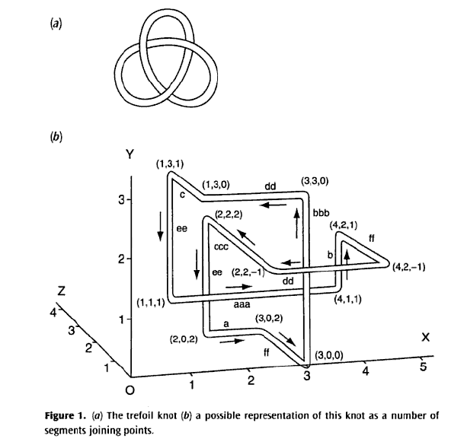

Slide 15
The solvability or NOT - of the ‘trefoil knot’ problem II
One can turn a knot into an equivalent one by operations of the following kinds:
  One may move a letter from one end of the row to the other.
  One may interchange two consecutive letters provided this still gives a knot.
  One may introduce a letter a in one place in the row, and d somewhere else, or b and e, or c and f, or take such pairs out, provided it still gives a knot.
  One may replace a everywhere by aa and d by dd or replace each b and e by bb and ee or each c and f by cc and ff. One may also reverse any such operation.
  and these are all the moves that are necessary.
These knots provide an example of a puzzle where one cannot tell in advance how many arrangements of pieces may be involved (in this case the pieces are the letters a, b, c, d, e, f ), so that the usual method of determining whether the puzzle is solvable cannot be applied. Because of rules (iii) and (iv) the lengths of the sequences describing the knots may become indefinitely great. No systematic method is known by which one can tell whether two knots are the same.

Slide 16
Three Human Problem Solving Exemplars
I want to begin this lecture with three Human Problem Solving exemplars. They characterise the methodology, epistemology and philosophy of classical behavioural economics – almost in a ‘playful’ way. They also highlight the crucial difference between the anomaly mongering mania that characterise the approach of modern behavioural economics.
The three exemplars are:
Cake Cutting
Chess
Rubik’s Cube
I have selected them to show the crucial role played by algorithms in classical behavioural economics and the way this role undermines any starting point in the ‘equilibrium, efficiency, optimality’ underpinned anomaly mongering mania of modern behavioural economics

Slide 17
Fairness in the Rawls-Simon Mode-A Role for Thought Experiments
The work in political philosophy by John Rawls, dubbed Rawlsianism, takes as its starting point the argument that "most reasonable principles of justice are those everyone would accept and agree to from a fair position.“ Rawls employs a number of thought experiments—including the famous veil of ignorance—to determine what constitutes a fair agreement in which "everyone is impartially situated as equals," in order to determine principles of social justice.
Hence, to understand Problem Solving as a foundation for Classical Behavioural Economics, I emphasise:
Mental Games
Thought Experiments (see Kuhn on ‘A Function for Thought Experiments)
Algorithms
Toys
Puzzles
Keynes and the ‘Banana Parable’; Sraffa and the ‘Construction of the Standard Commodity’, and so on.

Slide 18
Characterising Modern Behavioural Economics I
Let me begin with two observations by three of the undisputed frontier researches in ‘modern’ behavioural economics, Colin Camerer, George Lowenstein and Matthew Rabin, in the Preface to Advances in Behavioral Economics:
“Twenty years ago, behavioural economics did not exist as a field.” (p. xxi)
“Richard Thaler’s 1980 article ‘Toward a Theory of Consumer Choice’, of the remarkably open-minded (for its time) Journal of Economic Behavior and Organization, is considered by many to be the first genuine article in modern behavioural economics.” (p.xxii; underlining added)
I take it that this implies there was something called ‘behavioural economics’ before ‘modern behavioural economics. I shall call this ‘Calssical Behavioural Economics.’ I shall identify this ‘pre-modern’ behavioural economics as the ‘genuine’ article and link it with Herbert Simon’s pioneering work.

Slide 19
Characterising Modern Behavioural Economics II
Thaler, in turn, makes a few observations that have come to characterize the basic research strategy of modern behavioural economics. Here are some representative (even ‘choice’) selections, from this acknowledged classic of modern behavioural economics (pp. 39-40):
“Economists rarely draw the distinction between normative models of consumer choice and descriptive or positive models. .. This paper argues that exclusive reliance on the normative theory leads economists to make systematic, predictable errors in describing or forecasting consume choices.”
Hence we have modern behavioural economists writing books with titles such as:
Predictably Rational: The Hidden Forces that Shape our Decisions
By Dan Ariely
“Systematic, predictable differences between normative models of behavior and actual behavior occur because of what Herbert Simson (sic!!!) called ‘bounded rationality’:
    “The capacity of the human mind for formulating and solving complex problems is very small compared with the size of the problem whose solution is required for objectively rational behavior in the real world – or even for a reasonable approximation to such objective rationality.”
“This paper presents a group of economic mental illusions. These are classes of problems where consumers are … likely to deviate from the predictions of the normative model. By highlighting the specific instances in which the normative model fails to predict behavior, I hope to show the kinds of changes in the theory that will be necessary to make it more descriptive. Many of these changes are incorporated in a new descriptive model of choice under uncertainty called prospect theory.”

Slide 20
A Few Naïve Questions!
Why is there no attempt at axiomatising behaviour in classical behavioural economics?
In other words, why is there no wedge being driven between ‘normative behaviour’ and ‘actual behaviour’ within the framework of classical behavioural economics?
Has anyone succeeded in axiomatising the Feynman Integral?
Do architects, neurophysiologists, dentists and plumbers axiomatise their behaviour and their subject matter?

Slide 21
Characterising Modern Behavioural Economics III
Enter, therefore, Kahneman & Twersky!
But the benchmark, the normative model, remains the neoclassical vision, to which is added, at its ‘behavioural foundations’ a richer dose of psychological underpinnings – recognising, of course, that one of the pillars of the neoclassical trinity was always subjectively founded, albeit on flimsy psychological and psychophysical foundations. Hence, CLR, open their ‘Survey’ of the ‘Past, Present & Future’ of Behavioural Economics with the conviction and ‘mission’ statement:
“At the core of behavioral economics is the conviction that increasing the realism of the psychological underpinnings of economic analysis will improve the field of economics on its own terms - …… . This conviction does not imply a wholesale rejection of the neoclassical approach to economics based on utility maximization, equilibrium and efficiency. The neoclassical approach is useful because it provides economists with a theoretical framework that can be applied to almost any form of economic (and even noneconomic) behavior, and it makes refutable predictions.”
Or, as the alleged pioneer of modern behavioural economics stated: ‘[E]ven rats obey the law of demand’.
Sonnenschein, Debreu and Mantel must be turning in their grave.
In modern behavioural economics, ‘behavioural decision research’ us ‘typically classified into two categories: Judgement & Choice
Judgement research deals with the processes people use to estimate probabilities.
Choice deals with the processes people use to select among actions.
Recall that one of the later founding father’s of neoclassical economics, Edgeworth, titled his most important book: Mathematical Psychics and even postulated the feasibility of constructing a hedonimeter, at a time when the ruling paradigm in psychophysics was the Weber-Fechner law.

Slide 22
Characterising Modern Behavioural Economics IV
The modern behavioural economist’s four-step methodological ‘recipe’ (CLR, p. 7):
Identify normative assumptions or models that are ubiquitously used by economists (expected utility, Bayseian updating, discounted utility, etc.);
Identify anomalies, paradoxes, dilemmas, puzzles – i.e., demonstrate clear violations of the assumptions or models in ‘real-life’ experiments or via ‘thought-experiments’;
Use the anomalies as spring-boards to suggest alternative theories that generalize the existing normative models;
These alternative theories characterise ‘modern behavioural economics’
Two Remarks:
Note: there is no suggestion that we give up, wholesale, or even partially, the existing normative models!
Nor is there the slightest suggestion that one may not have met these ‘anomalies, paradoxes, dilemmas, puzzles, etc., in an alternative normative model!

Slide 23
Solvable and Unsolvable Problems
“One might ask, ‘How can one tell whether a puzzle is solvable?’, .. this cannot be answered so straightforwardly. The fact of the matter is there is no systematic method of testing puzzles to see whether they are solvable or not. If by this one meant merely that nobody had ever yet found a test which could be applied to any puzzle, there would be nothing at all remarkable in the statement. It would have been a great achievement to have invented such a test, so we can hardly be surprised that it has never been done. But it is not merely that the test has never been found. It has been proved that no such test ever can be found.”
Alan Turing, 1954, Science News
Substitution Puzzle:
A finite number of different kinds of ‘counters’, say just two: black (B) & white (W);
Each kind is in unlimited supply;
Initially a (finite) number of counters are arranged in a row.
Problem: transform the initial configuration into another specified patters.
Given: a finite list of allowable substitutions. Eg:
(i). WBW → B;
(ii). BW → WBBW
6. Transform WBW into WBBBW Ans: WBW → WWBBW →WWBWBBW → WBBBW

Slide 24
What could Ellsberg have meant with
“non-probabilistic descriptions of uncertainty”?
I suggest they are algoritihmic probabilities.
What, then, are algorithmic probabilities?
They are definitely not any kind of subjective probabilities.
What are subjective probabilities?
Where do they reside?
How are they elicited?
What are the psychological foundations of subjective probabilities?
What are the cognitive foundations of subjective probabilities?
What are the mathematical foundations of subjective probabilities?
Are behavioural foundations built ‘up’ from psychological, cognitive and mathematical foundations?
If so, are they – the psychological, the cognitive and the mathematical – consistent with each other?
If not consistent, then what? So, what? Why not?

Slide 25
Why NOT Equilibrium, Efficiency, Optimality, CGE ? (I)
The Bolzano-Weierstrass Theorem (from Classical Real Analysis)
Specker’s Theorem (from Computable Analysis)
Blume’s ‘Speed up Theorem (from Computability Theory)
In computational complexity theory Blum's speedup theorem is about the complexity of computable functions. Every computable function has an infinite number of different program representations in a given programming language. In computability theory one often needs to find a program with the smallest complexity for a given computable function and a given complexity measure. Blum's speedup theorem states that for any complexity measure there are computable functions which have no smallest program.
In classical real analysis, the Bolzano–Weierstrass theorem states that for each bounded sequence in R^{n} ,  a convergent subsequence.
In Computable Analysis Specker’s Theorem is about bounded monotone sequences that do not converge to a limit.
No Smallest Program; No Convergence to a Limit; No Decidable Subsequence
WHY NOT?

Slide 26
Why NOT Equilibrium, Efficiency, Optimality, CGE ? (II)
Preliminaries:
Let G be the partial recursive functions: g₀, g₁, g₂, …. . Then the s-m-n theorem and the recursion theorems hold for G. Hence, there is a universal partial recursive function for this class. To each g_{i} , we associate as a complexity function any partial recursive function, C_{i} , satisfying the following two properties:
(i). C_{i} (n) is defined iff g_{i} (n) is defined;
(ii).  a total recursive function M, s.t., M(i,n,m) = 1, if C_{i} (n) = m; and M(i,n,m) = 0, otherwise.
M is referred to as a measure on computation.
Theorem 2: The Blum Speedup Theorem
Let g be a computable function. Let C be a complexity measure.
Then:
∃ A computable f such that, given ϕ_{i} = f, ∃ j with ϕ_{j} = f, and:
g[C_{j} (x)] < C_{i} (x), ∀ x ≥ some n₀ ∈ N
Remark:
This means, roughly, for any class of computable functions, and for any program to compute a function in this class, there is another program giving the result faster. However, there is no effective way to find the j whose existence is guaranteed in the theorem.

Slide 27
Why NOT Equilibrium, Efficiency, Optimality, CGE ? (III)
Consider:   
Then: x_{A} := ∑_{i∈} 2^{-i} is computable   is recursive
Now: Let    be recursively enumerable but not recursive.
Theorem:
The real number x_{A} := ∑_{i∈} 2^{-i} is NOT computable.
Proof:
From computability theory: A = range (f) for some computable injective function, f: →.
Therefore, x_{A} = ∑_{i∈} 2^{-f(i)} .
Then: (x₀, x₁, …….), with , x_{n} = ∑_{i≤n} 2^{-f(i)} is an increasing and bounded computable sequence of rational numbers. However, its limit is the non-computable real number x_{A}.
Remark:
Such a sequence is called a Specker Sequence.
Theorem 3: Specker’s Theorem
  ∃ a strictly monotone, increasing, and bounded sequence b_{n} that does not converge to a limit.
Theorem 4:
∃ A sequence with an upper bound but without a least upper bound.

Slide 28
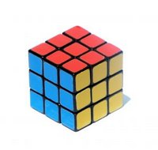
Tuesday, August 14, 2007
Rubik's cube solvable in 26 moves or fewer
Computer scientists Dan Kunkle and Gene Cooperman at Northeastern University in Boston, US, have proved that any possible configuration of a Rubik's cube can be returned to the starting arrangement in 26 moves or fewer.
Kunkle and Cooperman used a supercomputer to figure this out, but their effort also required some clever maths. This is because there are a mind-numbing 43 quintillion (43,000,000,000,000,000,000) possible configurations for a cube - too many for even the most powerful machine to analyse one after the other.
So the pair simplified the problem in several ways.
First, they narrowed it down by figuring out which arrangements of a cube are equivalent. Only one of these configurations then has to be considered in the analysis.
Next, they identified 15,000 special arrangements that could be solved in 13 or fewer "half rotations" of the cube. They then worked out how to transform all other configurations into these special cases by classifying them into "sets" with transmutable properties.
But this only showed that any cube configuration could be solved in 29 moves at most. To get the number of moves down to 26 (and beat the previous record of 27), they discounted arrangements they had already shown could be solved in 26 moves or fewer, leaving 80 million configurations. Then they focused on analysing these 80 million cases and showing that they too can be solved in 26 or fewer moves.
This isn't the end of the matter, though. Most mathematicians think it really only takes 20 moves to solve any Rubik's cube - it's just a question of proving this to be true.

Slide 29
Three remarks on Rubik’s Cube
It is not known how many moves is the minimum required to solve any instance of the Rubik's cube, although the latest claims put this number at 22. This number is also known as the diameter of the Cayley graph of the Rubik's Cube group. An algorithm that solves a cube in the minimum number of moves is known as 'God's algorithm'. Most mathematicians think it really only takes 20 moves to solve any Rubik's cube - it's just a question of proving this to be true.
Lower Bounds: It can be proven by counting arguments that there exist positions needing at least 18 moves to solve. To show this, first count the number of cube positions that exist in total, then count the number of positions achievable using at most 17 moves. It turns out that the latter number is smaller. This argument was not improved upon for many years. Also, it is not a constructive proof: it does not exhibit a concrete position that needs this many moves.
Upper Bounds: The first upper bounds were based on the 'human' algorithms. By combining the worst-case scenarios for each part of these algorithms, the typical upper bound was found to be around 100. The breakthrough was found by Morwen Thistlethwaite; details of Thistlethwaite's Algorithm were published in Scientific American in 1981 by Douglas Hofstadter. The approaches to the cube that lead to algorithms with very few moves are based on group theory and on extensive computer searches. Thistlethwaite's idea was to divide the problem into subproblems. Where algorithms up to that point divided the problem by looking at the parts of the cube that should remain fixed, he divided it by restricting the type of moves you could execute.

Slide 30
God’ Number & God’s Algorithm
In 1982, Singmaster and Frey ended their book on Cubik Math with the conjecture that ‘God’s number’ is in the low 20’s:
  “No one knows how many moves would be needed for ‘God’s Algorithm’ assuming he always used the fewest moves required to restore the cube. It has been proven that some patterns must exist that require at least seventeen moves to restore but no one knows what those patterns may be. Experienced group theorists have conjectured that the smallest number of moves which would be sufficient to restore any scrambled pattern – that is, the number required for ‘God’s Algorithm’ – is probably in the low twenties.”
  This conjecture remains unproven today.
Daniel Kunkle & Gene Cooperman: Twenty-Six Moves Suffice for Rubik’s Cube, ISSAC’07, July 29-August 1, 2007; p.1

Slide 31
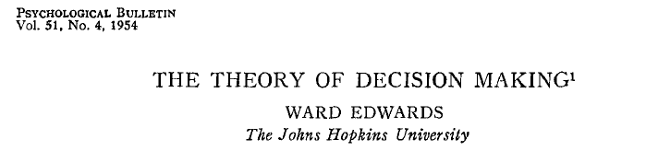
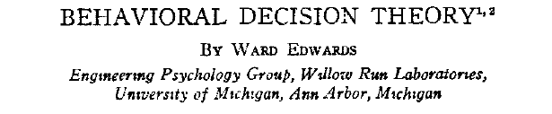
The Pioneer of Modern Behavioural Economics
Annual Review of Psychology, 1961, Vol. 12, pp. 473-498.

Slide 32
SEU
“The combination of subjective value or utility and objective probability characterizes the expected utility maximization model; Von Neumann & Morgenstern defended this model and, thus, made it important, but in 1954 it was already clear that it too does not fit the facts. Work since then has focussed on the model which asserts that people maximize the product of utility and subjective probability. I have named this the subjective expected utility maximization model (SEU model).”
Ward Edwards, 1961, p. 474

Slide 33
Varieties of Theories of Probability
Logical Probabilities as Degrees of Belief: Keynes-Ramsey
Frequency Theory of Probability: Richard von Mises
Measure Theoretic Probability: Kolmogorov
Subjective-Personalistic Theory of Probability: De Finetti – Savage.
Bayesian Subjective Theory of Probability: Harold Jeffryes
Potential Surprise: George Shackle
Algorithmic Probability: Kolmogorov

Slide 34
A Debreu-Tversky Saga
Consider the following axiomatization of Individual Choice Behaviour by Duncan Luce (considered by Professor Shu-Heng Chen in his lectures).
Consider an agent faced with the set U of possible alternatives.
Let T be a finite subset of U from which the subject must choose an element.
Denote by P_{T} (S) the probability that the element that he/she elects belongs to the subset S of T.
Axiom(s): Let T be a finite subset of U s.t, ∀ S ⊂ T, P_{S} is defined.
If P(x,y) ≠ 0, 1, ∀ x,y  T, then for R ⊂ S ⊂ T: P_{T} (R) = P_{S} (R) P_{T} (S);
If P(x,y) = 0 for some x, y  T, then ∀ S ⊂ T: P_{T} (S) = P_{T-{x}} (S – {x})
Where: P(x,y) denotes P_{[x,y]} (x) whenever x ≠ y, with P(x,x) = ½.
See: Debreu’s review of Individual Choice Behaviour by Duncan Luce, AER, March, 1960, pp. 186-188.
What is the cardinality of U?
What kind of probabilities are being used here?
What does ‘choose’ mean?
What is an ‘agent’?

Slide 35
A Debreu-Tversky Saga – continued (I)
Let the set U have the following three elements:
D_{C} : A recording of the Debussy quartet by the C quartet;
B_{F} : A recording of the eighth symphony by Beethoven by the B orchestra conducted by F;
B_{K} : A recording of the eighth symphony by Beethoven by the B orchestra conducted by K;
The subject will be presented with a subset U and will be asked to choose an element in that subset, and will listen to the recording he has chosen.
When presented with {D_{C} ,B_{F}} he chooses D_{C} with probability 3/5;
When presented with {B_{F} ,B_{K}} he chooses B_{F} with probability ½;
When presented with {D_{C} ,B_{K}} he chooses D_{C} with probability 3/5;
What happens if he is presented with {D_{C} ,B_{F} ,B_{K}}?
According to the axiom, he must choose D_{C} with probability 3/7.
Thus if he can choose between D_{C} and B_{F} , he would rather have Debussy.
However, if he can choose between D_{C} , B_{F} & B_{K} , while being indifferent between B_{F} & B_{K} , he would rather have Beethoven.
To meet this difficulty one might say that the alternatives have not been properly defined.
But how far can one go in the direction of redefining the alternatives to suit the axiom without transforming the latter into a useless tautology?

Slide 36
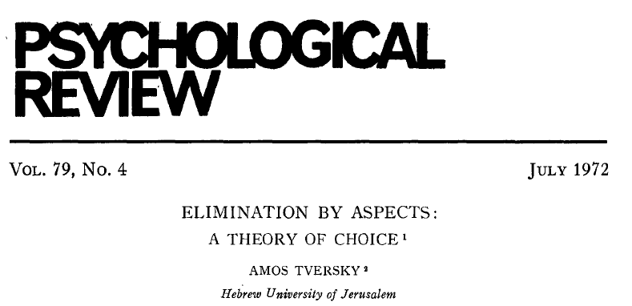
A Debreu-Tversky Saga – continued (II)

Slide 37
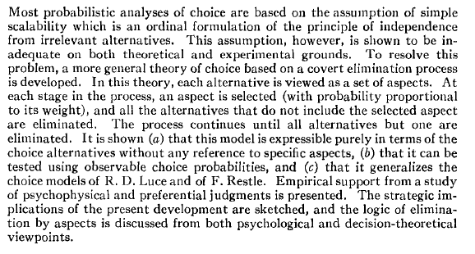
A Debreu-Tversky Saga – continued (III)

Slide 38
A Debreu-Tversky Saga – continued (IV)
“We begin by introducing some notation.
Let T = {x,y,z,…} be a finite set, interpreted as the total set of alternatives under consideration.
We use A, B, C, … to denote specific nonempty subsets of T, and A_{i} , B_{j} , C_{k} , to denote variables ranging over nonempty subsets of T.
Thus, {A_{i}  A_{i}  B} is the set of all subsets of T which includes B.
The number of elements in A is denoted by .
The probability of choosing an alternative x from an offered set A  T is denoted by P(x,A).
A real valued, nonnegative function in one argument is called a scale.
Choice probability is typically estimated by relative frequency in repeated choices.”
Tversky, 1972, p. 282
Whatever happened to U?
What is the cardinality of ‘the set of all subsets of T which includes B’
In forming this, is the power set axiom used?
If choice probabilities are estimated by relative frequency, whatever happened to SEU?
What is the connection between the kind of Probabilities in Debreu-Luce & those in Tversky?

Slide 39
A Debreu-Tversky Saga – continued (V)
“The most general formulation of the notion of independence from irrelevant alternatives is the assumption - called simple scalability - that the alternatives can be scaled so that each choice probability is expressible as a monotone function of the scale values of the respective alternatives.
To motivate the present development, let us examine the arguments against simple scalability starting with an example proposed by Debreu (1960: i.e., review of Luce).
Although Debreu’s example was offered as a criticism of Luce’s model, it applies to any model based on simple scalability.
Previous efforts to resolve this problem .. Attempted to redefine the alternatives so that B_{F} and B_{K} are no longer viewed as different alternatives. Although this idea has some appeal, it does not provide a satisfactory account of our problem.
The present development describes choice as a covert sequential elimination process.”
Tversky, op.cit, pp. 282-284
What was the lesson Debreu wanted to impart from his theoretical ‘counter-example’?
What was the lesson Tversky seemed to have inferred from his use of Debreu’s counter-example (to what)?

Slide 40
Some Simonian Reflections
On Human Problem Solving
On Chess
On Dynamics, Iteration and Simulation
&
Kolmogorov (& Brouwer) on the Human Mathematics of Human Problem Solving

Slide 41
Human Problem Solving á la Newell & Simon
“The theory [of Human Problem Solving] proclaims man to be an information processing system, at least when he is solving problems. …. [T]he basic hypothesis proposed and tested in [Human Problem Solving is]: that human beings, in their thinking and problem solving activities, operate as information processing systems.”
The Five general propositions, which are supported by the entire body of analysis in [Human Problem Solving] are:
  Humans, when engaged in problem solving in the kinds of tasks we have considered, are representable as information processing systems.
  This representation can be carried to great detail with fidelity in any specific instance of person and task.
  Substantial subject differences exist among programs, which are not simply parametric variations but involve differences of program structure, method and content.
  Substantial task differences exist among programs, which also are not simply parametric variations but involve differences of structure and content.
  The task environment (plus the intelligence of the problem solver) determine to a large extent the behaviour of the problem solver, independently of the detailed internal structure of his information processing system.

Slide 42
Human Problem Solving – the Problem Space
“The analysis of the theory we propose can be captured by four propositions:
  A few, and only a few, gross characteristics of the human IPS are invariant over task and problem solver.
  These characteristics are sufficient to determine that a task environment is represented (in the IPS) as a problem space, and that problem solving takes place in a problem space.
  The structure of the task environment determines the possible structures of the problem space.
  The structure of the problem space determines the possible programs that can be used for problem solving.
  […] Points 3 and 4 speak only of POSSIBILITIES, so that a fifth section must deal with the determination both of the actual problem space and of the actual program from their respective possibilities.

Slide 43
The Mathematics of Problem Solving: Kolmogorov
In addition to theoretical logic, which systemizes the proof schemata of theoretical truths, one can systematize the schemata of the solution of problems, for example, of geometrical construction problems. For example, corresponding to the principle of syllogisms the following principle occurs here: If we can reduce the solution of b to the solution of a, and the solution of c to the solution of b, then we can also reduce the solution of c to the solution of a.
One can introduce a corresponding symbolism and give the formal computational rules for the symbolical construction of the system os such schemata for the solution of problems. Thus in addition to theoretical logic one obtains a new calculus of problems. ….
Then the following remarkable fact hods: The calculus of problems is formally identical with the Brouwerian intuitionistic logic ….

Slide 44
Chess Playing Machines & Complexity
Chess Playing Programs and the Problem of Complexity
Allen Newell, Cliff Shaw & Herbert Simon
“In a normal 8 × 8 game of chess there are about 30 legal alternatives at each move, on the average, thus looking two moves ahead brings 30⁴ continuations, about 800,000, into consideration. …. By comparison, the best evidence suggests that a human player considers considerably less than 100 positions in the analysis of a move.”
The Chess Machine: An Example of Dealing with a Complex Task by Adaption
Allen Newell
“These mechanisms are so complicated that it is impossible to predict whether they will work. The justification for the present article is the intent to see if in fact an organized collection of rules of thumb can ‘pull itself up by its bootstraps’ and learn to play good chess.”
Please see also:
      NYRB, Volume 57, Number 2 · February 11, 2010
      The Chess Master and the Computer
      By Garry Kasparov

Slide 45
Penetrating the Core of Human Intellectual Endeavour
Chess is the intellectual game par excellence. Without a chance device to obscure the contest it pits two intellects against each other in a situation so complex that neither can hope to understand it completely, but sufficiently amenable to analysis that each can hope to out-think his opponent. The game is sufficiently deep and subtle in its implications to have supported the rise of professional players, and to have allowed a deepening analysis through 200 years of intensive study and play without becoming exhausted or barren. Such characteristics mark chess as a natural arena for attempts at mechanization. If one could devise a successful chess machine, one would seem to have penetrated to the core of human intellectual endeavour.
Newell, Shaw & Simon

Slide 46
Programming a Computer for Playing Chess by Claude E. Shannon
This paper is concerned with the problem of constructing a computing routine or ‘program’ for a modern general purpose computer which will enable it to play chess. …. The chess machine is an ideal one to start with, since:
the problem is sharply defined both in allowed operations (the moves) and in the ultimate goal (checkmate);
it is neither so simple as to be trivial nor too difficult for satisfactory solution;
chess is generally considered to require ‘thinking’ for skilful play; a solution of this problem will force us either to admit the possibility of mechanized thinking or to further restrict our concept of ‘thinking’;
the discrete structure of chess fits well into the digital nature of modern computers.

Slide 47
Chess is a determined game
In chess there is no chance element apart from the original choice of which player has the first move. .. Furthermore, in chess each of the two opponents has ‘perfect information’ at each move as to all previous moves. .. These two facts imply … that any given position of the chess pieces must be either:-
A won position for White. That is, White can force a win, however Black defends.
A draw position. White can force at least a draw, however Black plays, and likewise Black can force at least a draw, however White plays. If both sides play correctly the game will end in a draw.
A won position for Black. Black can force a win, however white plays.
This is, for practical purposes, of the nature of an existence theorem. No practical method is known for determining to which of the three categories a general position belongs. If there were chess would lost most of its interest as a game. One could determine whether the initial position is won, drawn, or lost for White and the outcome of a game between opponents knowing the method would be fully determined at the choice of the first move.

Slide 48
Newell and Simon on Algorithms as Dynamical Systems
"The theory proclaims man to be an information processing system, at least when he is solving problems. ......
An information processing theory is dynamic, ... , in the sense of describing the change in a system through time. Such a theory describes the time course of behavior, characterizing each new act as a function of the immediately preceding state of the organism and of its environment.
The natural formalism of the theory is the program, which plays a role directly analogous to systems of differential equations in theories with continuous state spaces ... .
All dynamic theories pose problems of similar sorts for the theorist. Fundamentally, he wants to infer the behavior of the system over long periods of time, given only the differential laws of motion. Several strategies of analysis are used, in the scientific work on dynamic theory. The most basic is taking a completely specific initial state and tracing out the time course of the system by applying iteratively the given laws that say what happens in the next instant of time. This is often, but not always, called simulation, and is one of the chief uses of computers throughout engineering and science. It is also the mainstay of the present work.“
Newell-Simon, pp. 9-102

Slide 49
Concluding Thoughts on Behavioural Economics
Nozick on Free Choices made by Turing Machines
Day on Solutions and Wisdom
Samuelson on the Imperialism of Optimization
Simon on Turing Machines & Thinking
Homage to Shu-Heng Chen’s Wisdom & Prescience

Slide 50
Behavioural Economics is Choice Theory?
“In what other way, if not simulation by a Turing machine, can we understand the process of making free choices? By making them, perhaps.”
Philosophical Explanations by Robert Nozick, p. 303

Slide 51
Three Vignettes from another of the Classical Behavioural Economists: Richard Day
[I]f answered in the affirmative, ‘Does a problem have a solution?’ implies the question ‘Can a procedure for finding it be constructed?’ Algorithms for constructing solutions of optimization problems may or may not succeed in finding an optimum …
In: Essays in Memory of Herbert Simon
[T]here should be continuing unmotivated search in an environment that may be ‘irregular’ or subject to drift or perturbation, or when local search in response to feedback can get ‘stuck’ in locally good, but globally suboptimal decisions. Such search can be driven by curiosity, eccentricity or ‘playfulness’, but not economic calculation of the usual kind. Evidently, the whole idea of an equilibrium is fundamentally incompatible with wise behaviour in an unfathomable world.”
JEBO, 1984
Rational choices
and wanted trades
perpetuated
Mindlessly
The Monarch Tree

Slide 52
Samelson on maximum principles in dynamics
I must not be too imperialisitc in making claims for the applicability of maximum principles in theoretical economics. There are plenty of areas in which they simply do not apply. Take for example my early paper dealing with the interaction of the accelerator and the multiplier. … [I]t provides a typical example of a dynamic system that can in no useful sense be related to a maximum problem. …. The fact that the accelerator-multiplier cannot be related to maximizing takes its toll in terms of the intractability of the analysis.
Non-Maximum Problems in PAS’s Nobel Lecture, 1970.
See also the Foreward to the Chinese Translation of FoA.
Hence:
Computation Universality as a foundation of classical behavioural economics

Slide 53
Simon on Turing Machines & Thinking – even wisely!
We need not talk about computers thinking in the future tense; they have been thinking … for forty years. They have been thinking ‘intuitively’ – even ‘creatively’.
Why has this conclusion been resisted so fiercely, even in the face of massive evidence? I would argue, first, that the dissenters have not looked very hard at the evidence, especially the evidence from the psychological laboratory. …
The human mind does not reach its goals mysteriously or miraculously. ….
Perhaps there are deeper sources of resistance to the evidence. Perhaps we are reluctant to give up our claims for human uniqueness – of being the only species that can think big thoughts. Perhaps we have ‘known’ so long that machines can’t think that only overwhelming evidence can change our belief. Whatever the reason, the evidence is now here, and it is time that we attended to it.
If we hurry, we can catch up to Turing on the path he pointed out to us so many years ago.
Machine as Mind, in: The Legacy of Alan Turing

Slide 54
Homage to Shu-Heng Chen’s Wisdom and Prescience
From Dartmouth to Classical Behavioural Economics – 1955-2010
We propose that a 2 month, 10 man study of artificial intelligence be carried out during the summer of 1956 at Dartmouth College in Hanover, New Hampshire.
The study is to proceed on the basis of the conjecture that every aspect of learning or any other feature of intelligence can in principle be so precisely described that a machine can be made to simulate it. An attempt will be made to find how to make machines use language, form abstractions and concepts, solve kinds of problems now reserved for humans, and improve themselves.
- Dartmouth AI Project Proposal; J. McCarthy et al.; Aug. 31, 1955.

